Slide 1
Analyzing Enrollment Patterns in EducationAL Institutions
Team Members:
Meghana Kota, Laasya Reddy Gaddam, Harshad Gupta Pasumarthy, Chandra Challa

Slide 2
INTRODUCTION
We have chosen Integrated Postsecondary Education Data System (IPEDS) dataset for research.
Our research investigates the change in the enrollment patterns across United States educational institutions in the year 2022, mainly focusing on the factors influencing the enrollment rate.
The research investigates the impact of institutional types, geographic location and various other economic factors which affect the enrollment rate by addressing the research question: “Examining the changes in enrollment patterns and degree offerings across various US higher education institutions and the factors influencing enrollment”.

Slide 3


LITERATURE REVIEW
Learning Analytics and Educational Data Mining(Romero & Ventura (2024)):
Provides a comprehensive overview of trends and techniques in educational data mining.
Highlights the role of learning analytics in extracting actionable insights from educational datasets.
Data-Driven Decision Making in Education(Gašević et al. (2015)):
Discusses how data-driven approaches can enhance student engagement and learning outcomes.
Emphasizes the importance of tailoring education strategies through data insights.
Large-Scale Educational Datasets(Lee et al. (2024)):
Introduced the EdNet dataset for analyzing educational systems at scale.
Stressed the potential of hierarchical data for tasks like knowledge tracing and adaptive learning.

Slide 4
METHODOLOGY
Integrated Postsecondary Education Data System (IPEDS) dataset provides comprehensive information on institutional characteristics, admissions and test scores, financial aid, enrollment, graduation rates, and more. The dataset contains information of 6,256 universities across the United States for the year 2022, with 30 columns detailing key aspects such as institution ID, name, location, state, region, enrollment numbers, admissions, applications, instructional staff, and graduate counts.
To aggregate the data, we used Excel’s VLOOKUP function, referencing UNITID, the unique identifier for each institution.
In the final dataset, we had numerous missing and negative values. Negative values indicated unavailable or irrelevant data, so we replaced these with 0. While there were no outliers, several rows had substantial missing data. We removed rows with more than 15 missing values, resulting in a dataset of 5,721 rows.
For the remaining missing values, we filled them using the minimum value of each column within each region, as region is a significant factor influencing students’ choices. The resultant and final dataset has a shape of (5721,30).
We have performed Exploratory Data Analysis(EDA) to analyze the patterns in the data. We have used Linear Regression and Random forest regressor to find the factors affecting the enrollment to investigate our research.

Slide 5
EXPLORATORY DATA ANALYSIS
Descriptive Statistics:
 | APPLCN | ADMSSN | ENRLT | SAINSTT | GRTOTLT | NPIST2 | OBEREG | CONTROL | HOSPITAL
count | 5721 | 5721 | 5721 | 5721 | 5721 | 5721 | 5721 | 5721 | 5721
mean | 6936.13 | 4097.30 | 895.51 | 344.66 | 3461.68 | 3409.72 | 4.63 | 2.05 | 0.82
std | 8013.20 | 3903.81 | 895.68 | 515.38 | 5160.19 | 5754.01 | 2.18 | 0.85 | 0.98
min | 0 | 0 | 0 | 2 | 2 | 0 | 0 | 1 | 0
25% | 3022.58 | 2203.02 | 564.66 | 98 | 819 | 0 | 3 | 1 | 0
50% | 6573.61 | 3935.09 | 866.88 | 324 | 3008 | 0 | 5 | 2 | 0
75% | 7645.65 | 5316.58 | 1005.53 | 368.29 | 3608.75 | 6503 | 6 | 3 | 2
max | 149801 | 61739 | 15151 | 8414 | 72219 | 45657 | 9 | 3 | 2

Slide 6
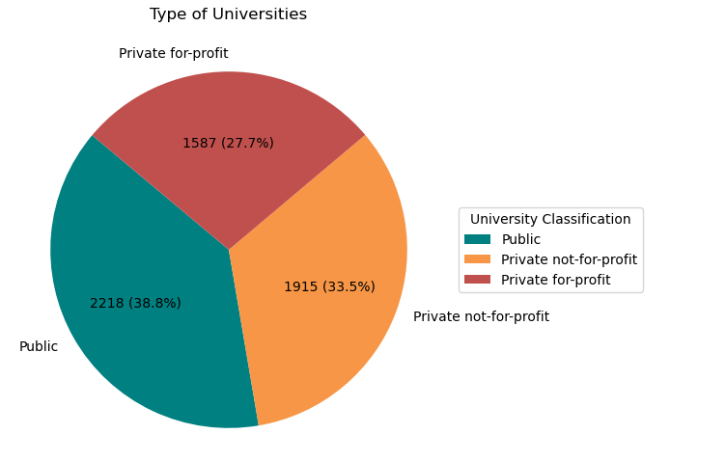
Classification based on type of university
The dataset has 5720 educational institutions. It has 1587 private non-profit institutions, 1915 private not-for-profit institutions and 2218 public institutions.

Slide 7
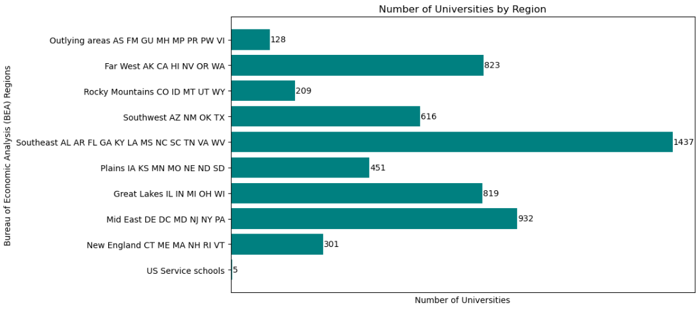
Number of institutions in each region
The southeast states – AL, AR, FL, GA, KY, LA, MS, NC, SC, TN, VA, WV has highest number of educational institutions. There are very few US service schools.

Slide 8
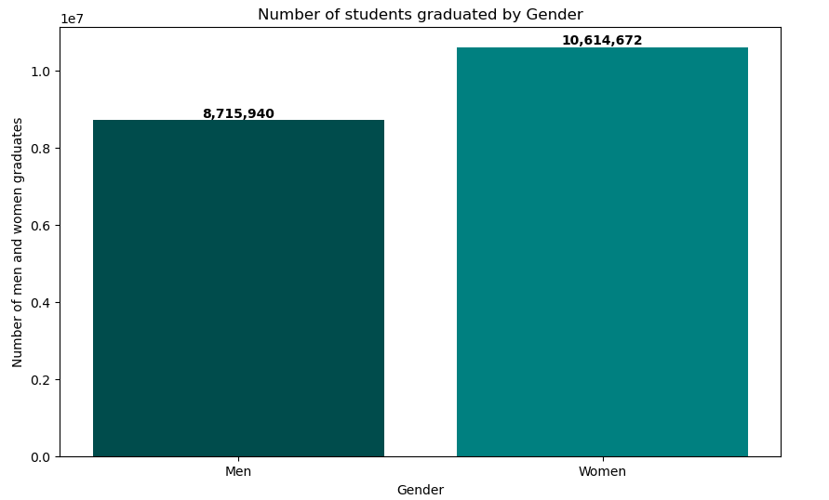
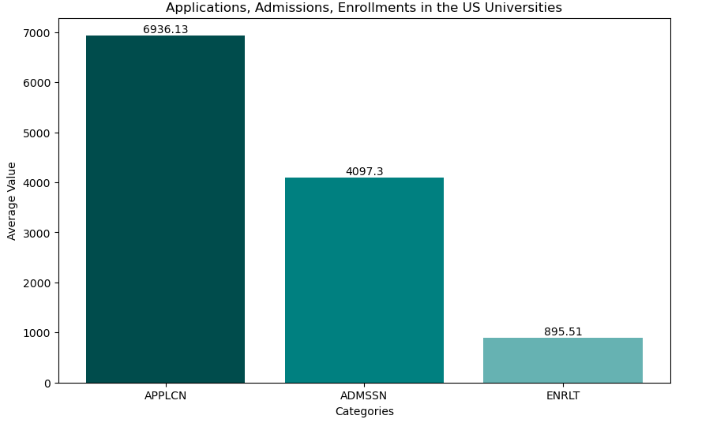
Average number of applications, admissions and enrollment in the United States
Number of students graduated by gender
The graduation count is high in women when compared to men. Total women graduates in 2022 are 10, 614,672, whereas men are 8,715,940.
Number of applications, Admissions and Enrollment are interdependent on each other. The above bar graph shows the average number of applications, admissions and enrollment across different institutes in the United States.

Slide 9
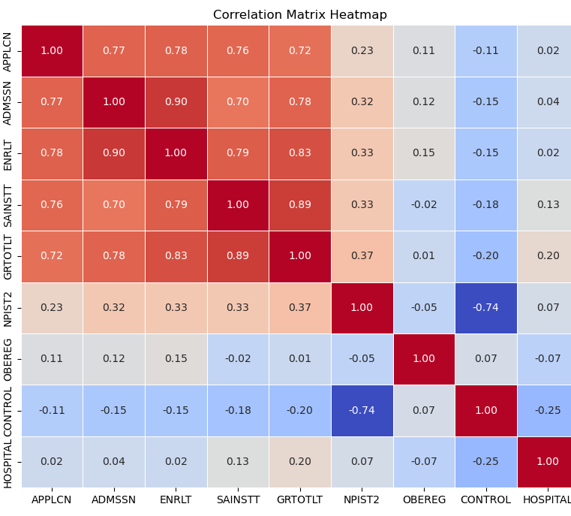
Correlation Matrix
The highest correlation is observed in between enrollment and admissions with the value of 0.90, followed by enrollment and graduation rate with the value of 0.78.

Slide 10
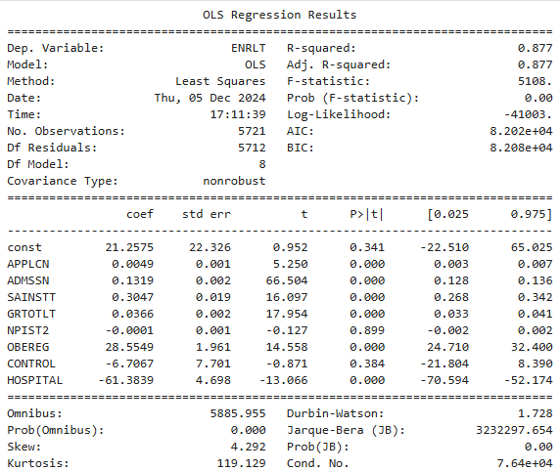
LINEAR REGRESSION
Linear regression is used to predict the value of enrollment based on the value of applications, admissions, graduation rate, financial aid, type of institution, region located and other facilities etc.
Regression equation of the model is:
ENRLT = 21.2575 + 0.0049 * APPLCN + 0.1319 * ADMSSN + 0.3047 * SAINSTT + 0.0366 * GRTOTLT – 0.0001 * NPIST2 + 28.5549 * OBEREG – 6.7067 * CONTROL – 61.3839 * HOSPITAL

Slide 11
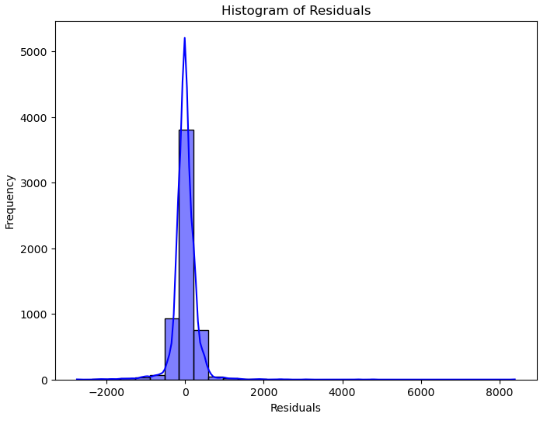
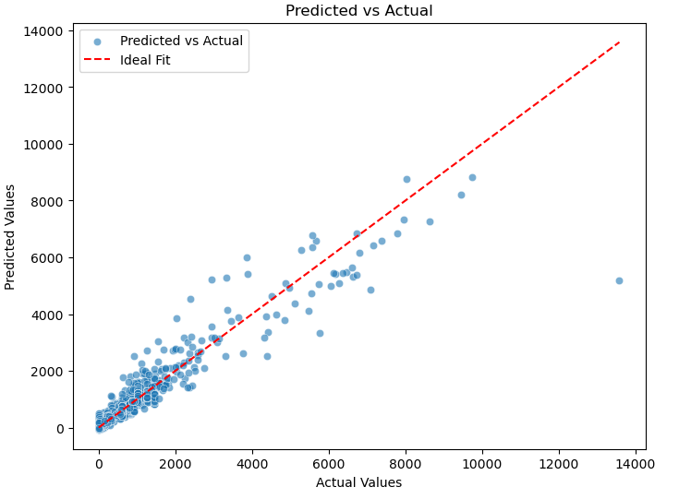
LINEAR REGRESSION
R²: 0.877 (good fit).
Significant predictors: Applications, Admissions, Graduation Rate.
Insignificant predictors: Institutional Type, Hospital Facilities.

Slide 12
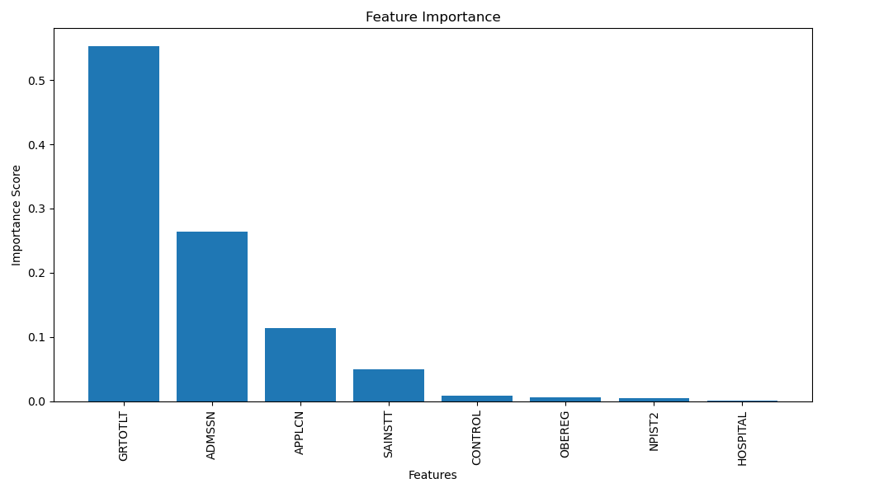
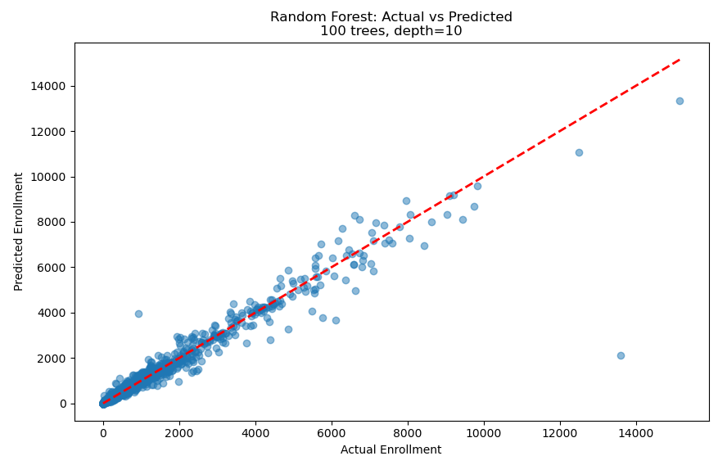
RANDOM FOREST REGRESSION
R²: 0.88.
Key predictors: Admissions, Applications, Graduation Rate
Admissions and graduation rate ranked highest in feature importance.

Slide 13
RESULTS
Highest correlation is observed in between enrollment and admissions with the value of 0.90.
R² value for linear regression model is 0.877 and R² value for random forest regression model is 0.88
Considering the results of both the models, we can say that admissions, applications, graduation rate and regions highly affect the enrollment in any educational institution. Hospital facilities and the type of institution, like private and public institutions, do not affect the enrollment rate.

Slide 14
CONCLUSION
The study offers information for institutional strategic planning. Program creation and comprehension of changing dynamics in higher education. Policymakers can create more focused educational initiatives, and the administrators can use data-driven insights.
Prospective students are able to make better informed decisions about their education. Although the study only includes data from 2022. Future investigations could extend temporal analysis, include more detailed demographic information, examine new developments in online and hybrid education.

Slide 15
REFERENCES
Romero, C., & Ventura, S. (2024). Educational Data Mining and Learning Analytics: An Updated Survey. arXiv preprint arXiv:2402.07956.
Global Data Set on Education Quality (1965-2015)" - Altinok, N., Angrist, N., & Patrinos, H. A. (2018). World Bank
Lee, Y., et al. (2024). EdNet: A Large-Scale Hierarchical Dataset in Education. arXiv preprint arXiv:1912.03072.
Gašević, D., Dawson, S. & Siemens, G. Let’s not forget: Learning analytics are about learning. TECHTRENDS TECH TRENDS 59, 64–71 (2015). https://doi.org/10.1007/s11528-014-0822-x

